Slide 1
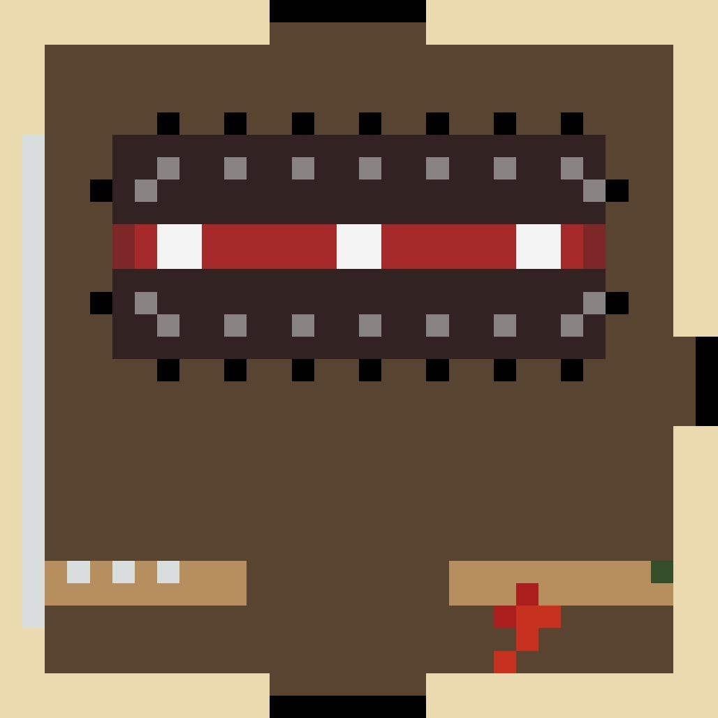
Haunted Mansion
By Jonah F, Rachel K, Hannah V, Audrey W, & Courtney R

Slide 2
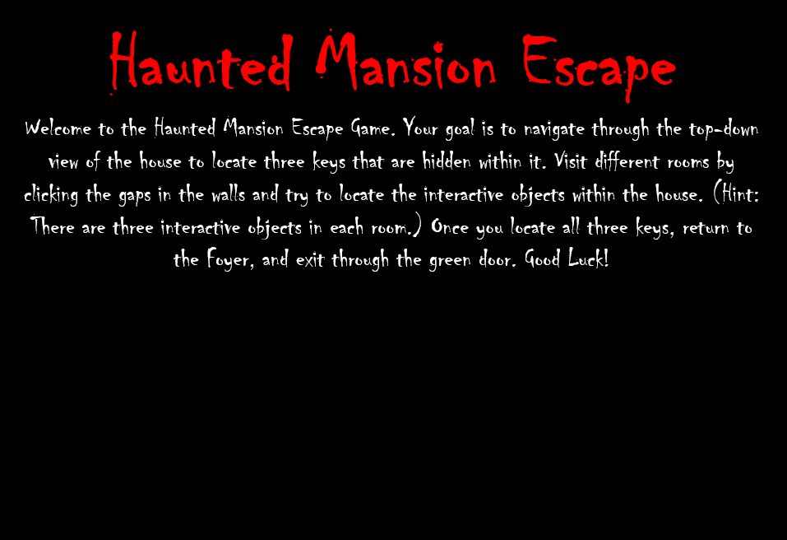
Key Concept
A scavenger hunt game with a retro feel where the player must find multiple keys within objects in different rooms of the mansion. Once the player finds all the keys they can escape the mansion.

Slide 3
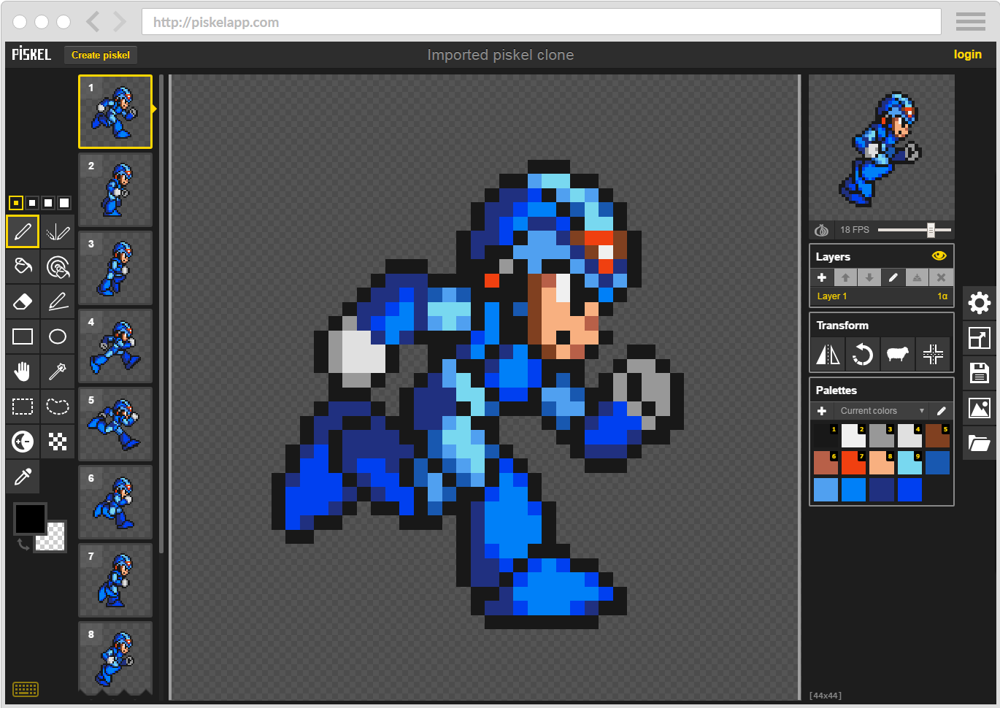

Game Graphics
Using Piskel online, I made separate frames
for each of the rooms. Piskel is typically also used to make pixel art for moving people, objects, etc. within games.

Slide 4
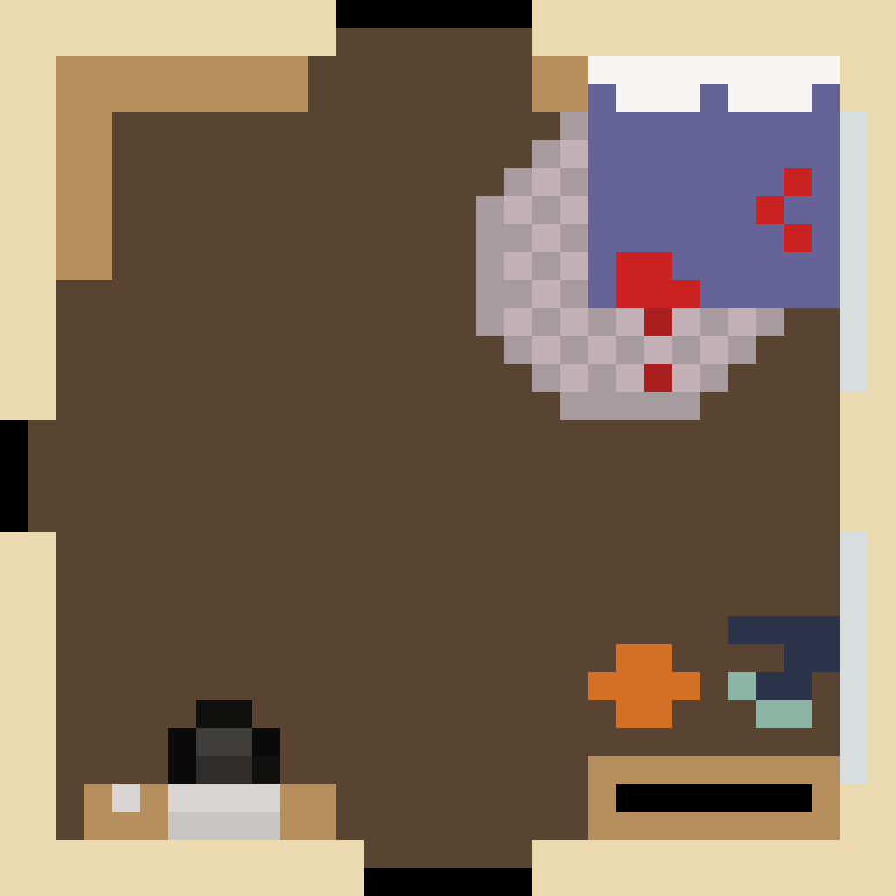
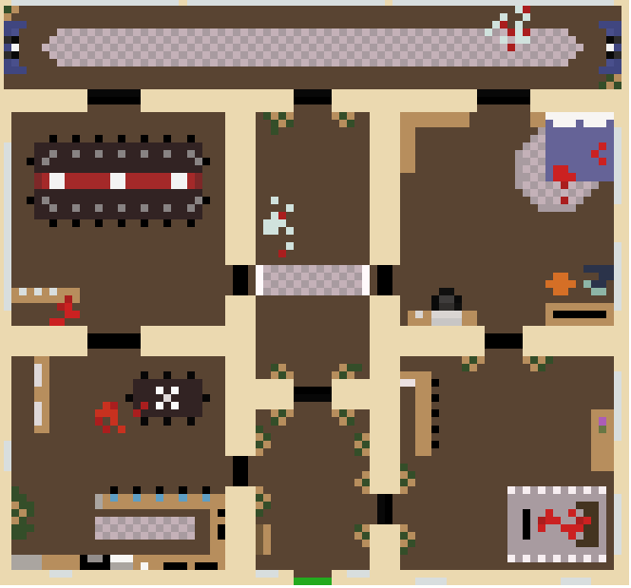

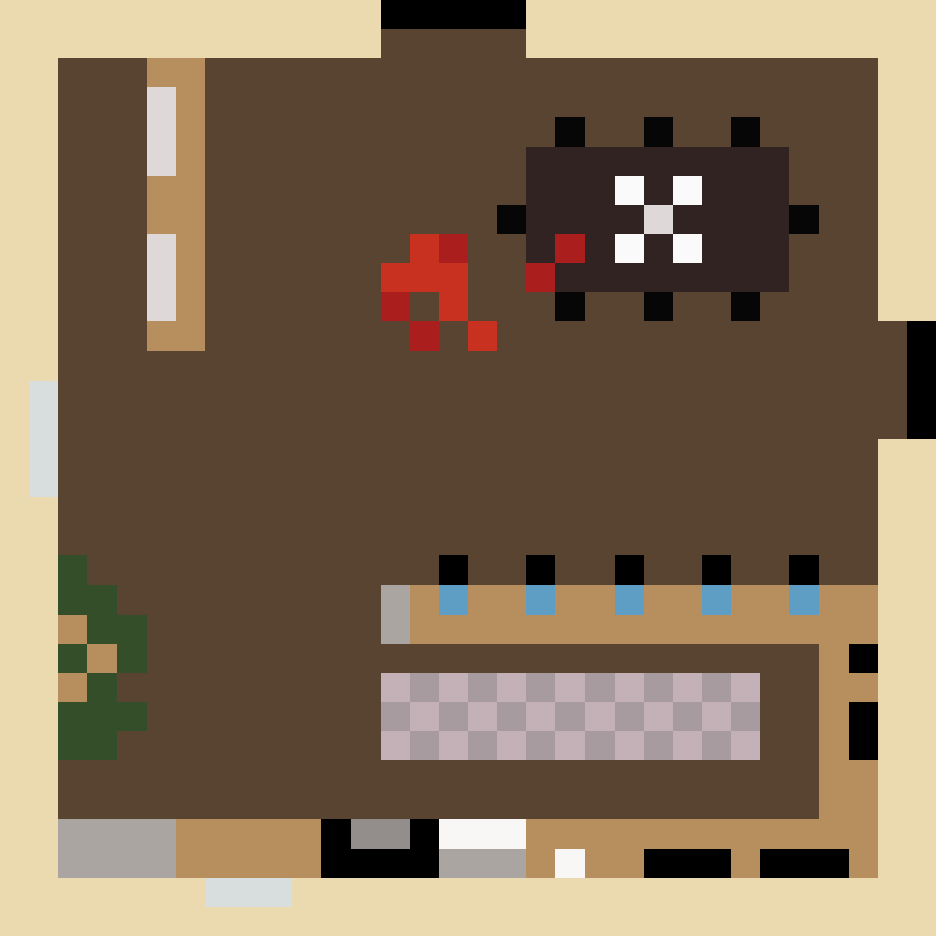
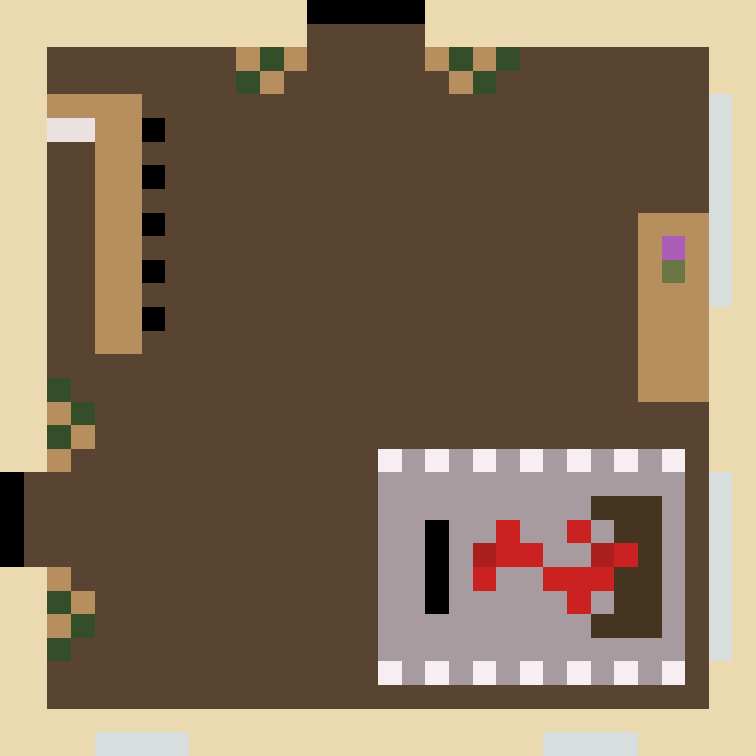
Rooms
Full Map
VS.
Some rooms needed to be altered in size just to all fit together for the full map, but the separate rooms were used in the actual gameplay.

Slide 5
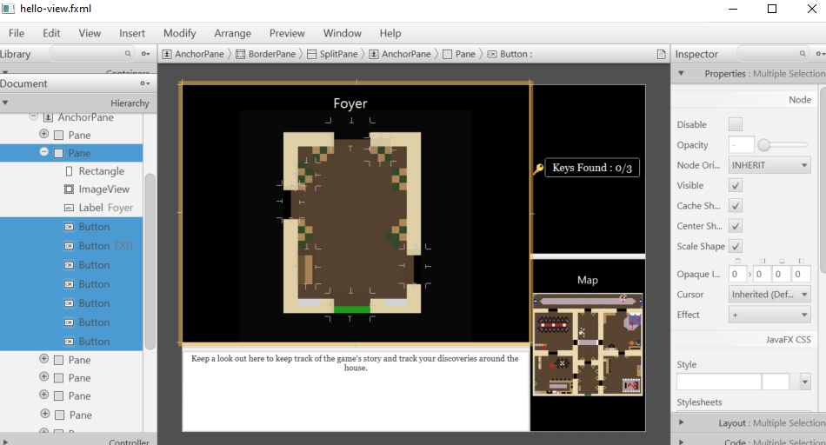
SceneBuilder

Slide 6
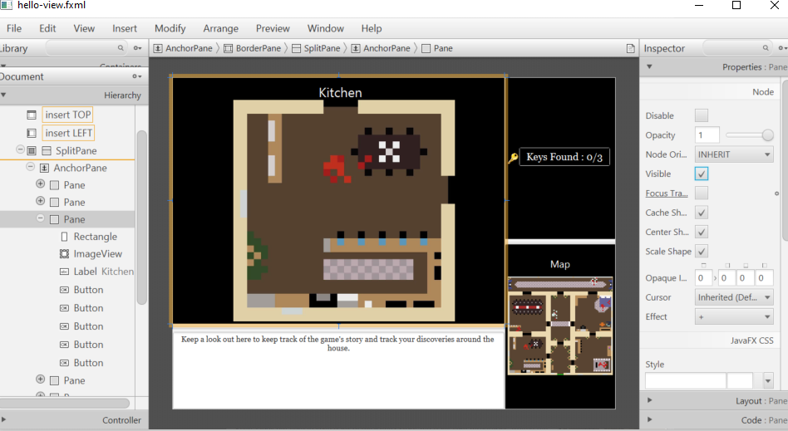
SceneBuilder

Slide 7
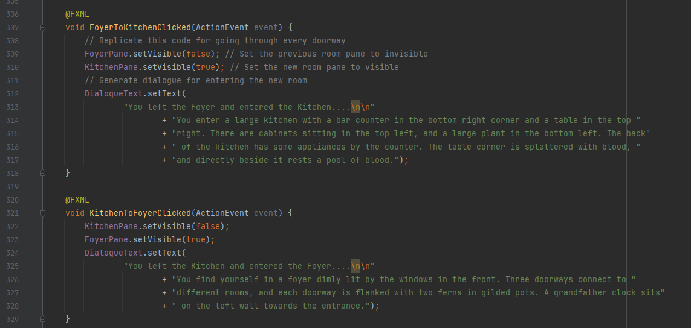
Moving Rooms

Slide 8
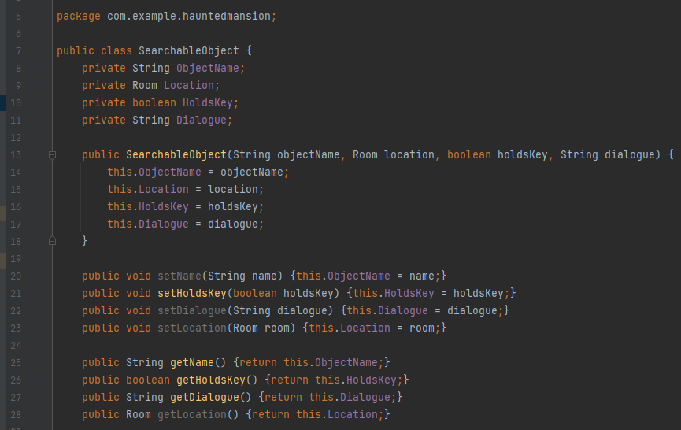
Searchable Object Class

Slide 9
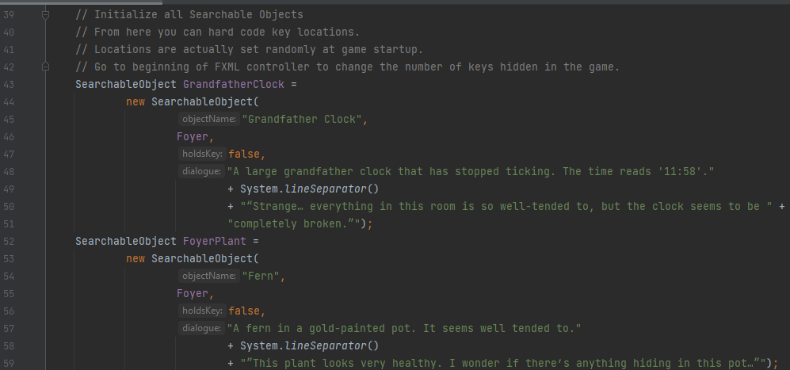
Initialize Searchable Objects

Slide 10
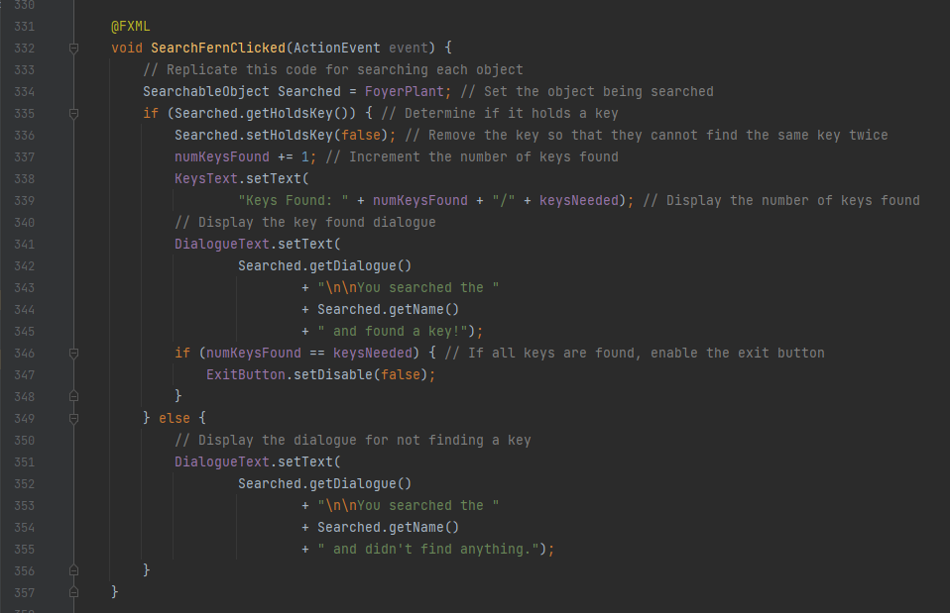
Searching an Object

Slide 11
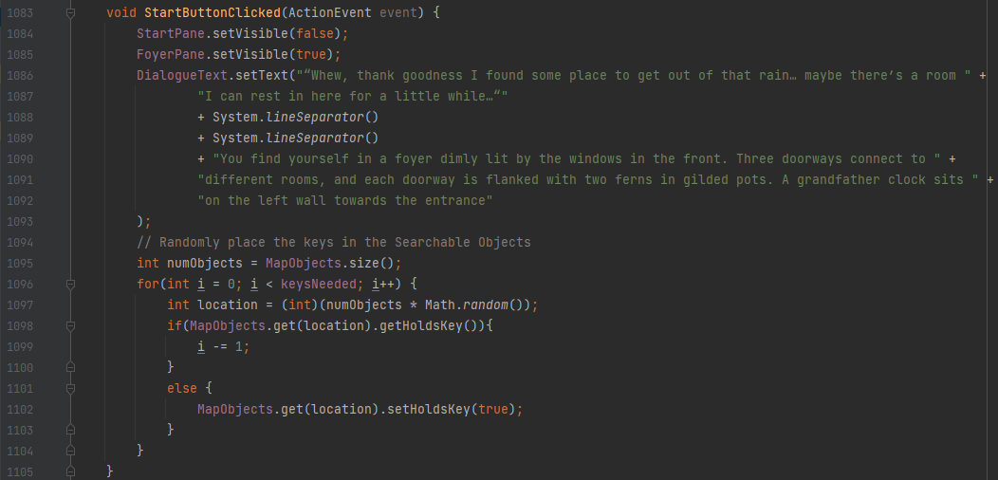
Starting the Game & Placing Keys

Slide 12
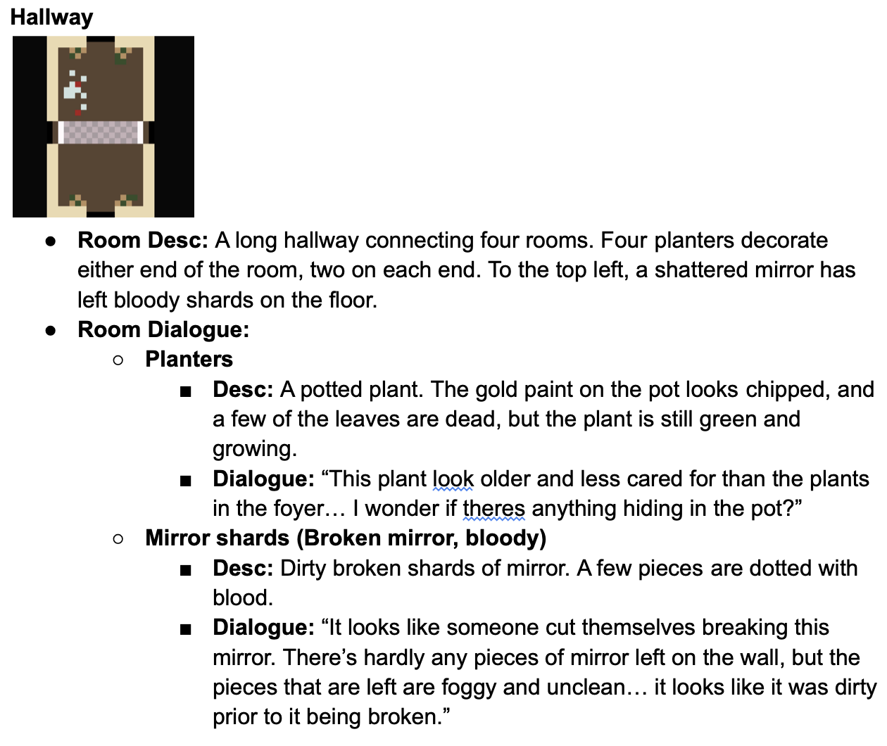
Storyboard
Changes with randomization of which
Mechanics
List off intractable objects with dialogue & narrative that changes in each room
Rooms with dialogue & description
Adaptive text
Planning
Storyboarding one room at a time
Small-story telling aspect

Slide 13
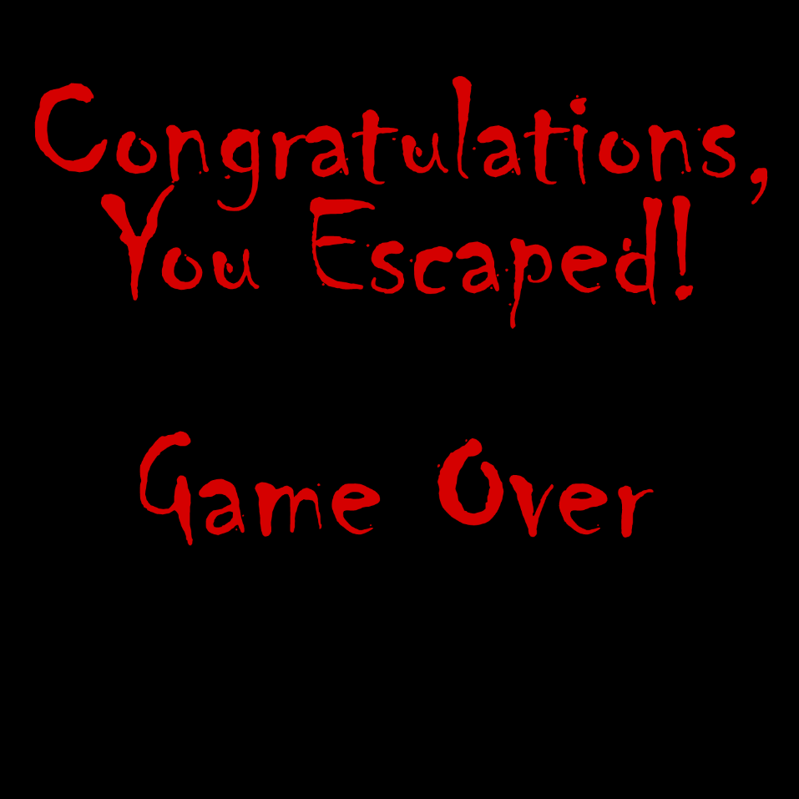
The game-play!

